Slide 1
Manna Yatri
Analysis on a cab company

Slide 2
AGENDA
01
BACKGROUND
Details on
the company
02
Tables
All the
tables involved
03
Queries
Analysis on
how it has
performed so far
04
CLOSING
Questions
Thank You

Slide 3
Background
Manna Yatri is a cab company that was started in 2021 and started with 1 city in bengaluru and now currently is riding in 12 different cities
Little information on the company

Slide 4
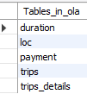
Tables
All the tables that are involved

Slide 5
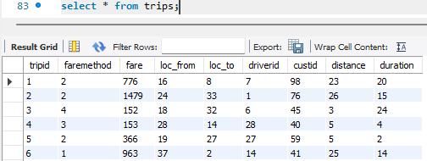
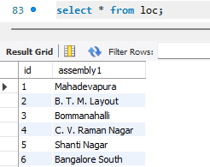
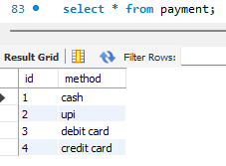
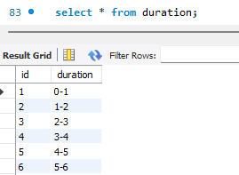
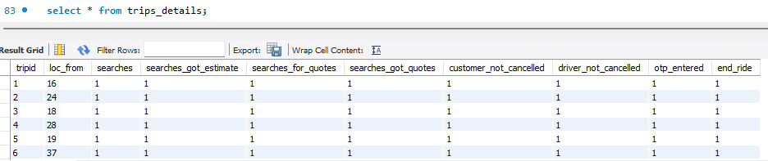
1)
2)
4)
3)
5)

Slide 6
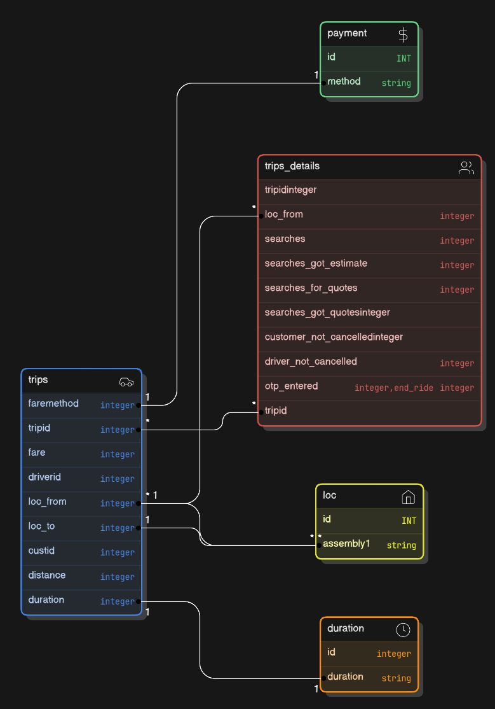
ER Diagram of the Tables in OLA database.

Slide 7
Queries
max growth
All the queries that were used to find some information for the analysis from the data.

Slide 8



-- total trips
select count(distinct tripid) from trips;
-- total drivers
select count(distinct driverid) from trips;
-- total earnings
select sum(fare) from trips;

Slide 9


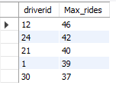
-- total Completed trips
select sum(end_ride) from trips_details;
-- total driver not cancelled
select count(driver_not_cancelled) from trips_details
where driver_not_cancelled = 0;
-- Top 5 most active drivers
select driverid, count(driverid) as Max_rides from trips
group by driverid order by Max_rides desc limit 5;

Slide 10



-- cancelled bookings by driver
select count(driver_not_cancelled) as drivers_cancelled from trips_details
where driver_not_cancelled = 0;
-- average distance per trip
select sum(distance)/count(distance) from trips;
-- average fare per trip
select sum(fare)/count(fare) from trips;

Slide 11
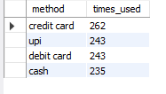
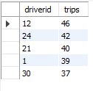

-- which is the most used payment method
select p.method, count(t.faremethod) as times_used from trips t
join payment p on p.id = t.faremethod group by p.method
order by times_used desc;
-- top 5 earning drivers
select driverid, count(driverid) as trips from trips
group by driverid order by trips desc limit 5;
-- which area got highest trips in which duration
select d.duration , count(t.duration) as max from trips t
join duration d on d.duration = t.duration
group by duration order by max desc limit 1;

Slide 12

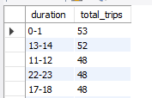
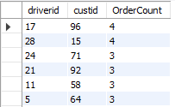
-- which two locations had the most trips
select l.assembly1, count(t.loc_from) as highest_trip from trips t
join loc l on t.loc_from = l.id group by l.assembly1
order by highest_trip desc limit 2;
-- which duration had more trips
select d.duration, count(t.tripid)as total_trips from trips t
join duration d on t.duration = d.id group by d.duration
order by total_trips desc limit 5;
-- which driver , customer pair had more orders
SELECT driverid, custid, COUNT(tripid) AS OrderCount FROM trips
GROUP BY driverid, custid ORDER BY OrderCount DESC;

Slide 13
-- procedure
-- Show customer by Pick up location --
DELIMITER //
CREATE PROCEDURE show_customer_by_pickup_location
(IN location VARCHAR(35))BEGIN SELECT t.custid FROM trips t
JOIN loc l ON t.loc_from = l.id
WHERE l.assembly1 = location;
END //
DELIMITER ;
-- Show customer by drop off location –
DELIMITER //
CREATE PROCEDURE show_customer_by_dropoff_location
(IN location VARCHAR(35))BEGIN SELECT t.custid FROM trips t
JOIN loc l ON t.loc_to = l.id
WHERE l.assembly1 = location;
END //
DELIMITER ;

Slide 14
-- trigger for adding if any new customer entry is recorded
DELIMITER $$
CREATE TRIGGER after_customer_insert
AFTER INSERT ON trips
FOR EACH ROWBEGIN
INSERT INTO new_trips (tripid ,faremethod ,fare ,loc_from ,loc_to ,driverid ,custid ,distance ,duration ) VALUES (new.tripid ,new.faremethod ,new.fare ,new.loc_from ,new.loc_to ,new.driverid ,new.custid ,new.distance ,new.duration);
END;
$$

Slide 15
That’s it for today !!!
If there are any questions do let me know

